Slide 1

SMART BED
Uche Chibuikem
Adrian
Alexsy

Slide 2
WHAT IS SMART BED?
Smart-Bed is an IoT-powered system that enhances sleep safety, comfort and accessibility through smart automation.
WHO IS SMART BED FOR?
SmartBed is designed for a diverse range of users, particularly:
Elderly Individuals: Supporting independent living through bed occupancy monitoring and optional caregiver alerts.
People with Limited Mobility: Providing accessible controls and automated functions that reduce physical effort.
Individuals with Hearing Impairments: Offering vibration-based alarms as an alternative to traditional sound-only alerts.
Heavy Sleepers: Combining physical vibrations and audio alarms for more reliable wake-up assistance.
Caregivers: Providing potential bed-exit notifications and monitoring features to support vulnerable individuals.
Our Vision: To make everyday sleeping and waking experiences safer, smarter and more accessible for everyone.

Slide 3
The problem is real, and local
    62,000 older adults in Ireland need medical care after a fall each year, and bed exit is a high-risk moment. Ireland also has thousands of excess winter deaths among people in cold homes.
    32,000 of them end up in an emergency department
    2,000 excess winter deaths a year, mostly people over 65 in cold homes

Slide 4
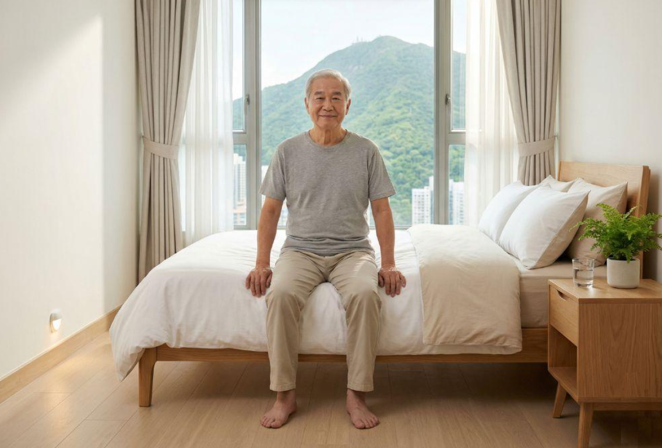
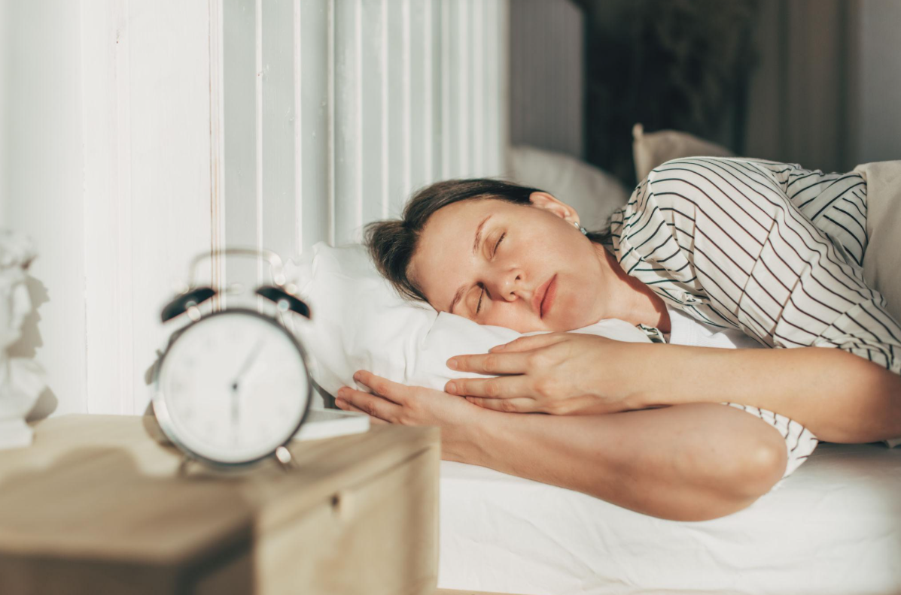
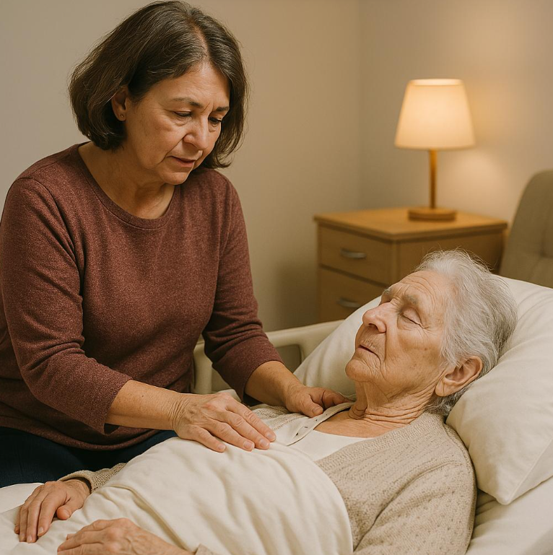
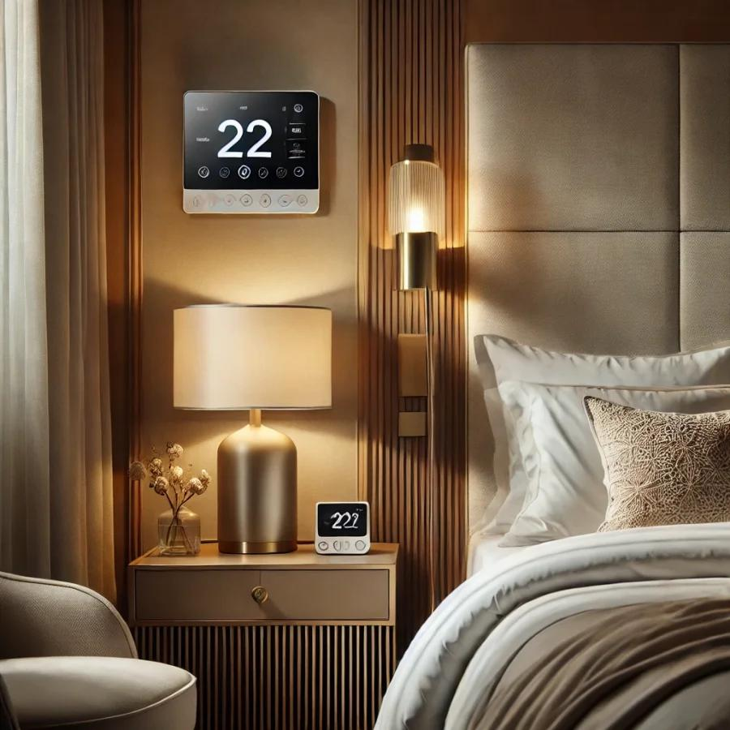
Use Cases/UTSE Analysis
1. Supporting Elderly Users & People with Limited Mobility
Enables users to wake up comfortably using gentle mattress vibrations and accessible stop/snooze controls, reducing the need for physical movement.
2. Improving Wake-Up Reliability for Heavy Sleepers
Combines mattress vibrations, sound and gradually increasing intensity to provide a more noticeable wake-up experience.
3. Supporting Independent Living & Caregiving
Uses bed occupancy detection to identify whether a user has got out of bed, with potential caregiver notifications when they haven’t.
4. Personalising Sleep Comfort
Allows users to customise wake-up settings and optionally schedule bed warming based on room conditions.

Slide 5
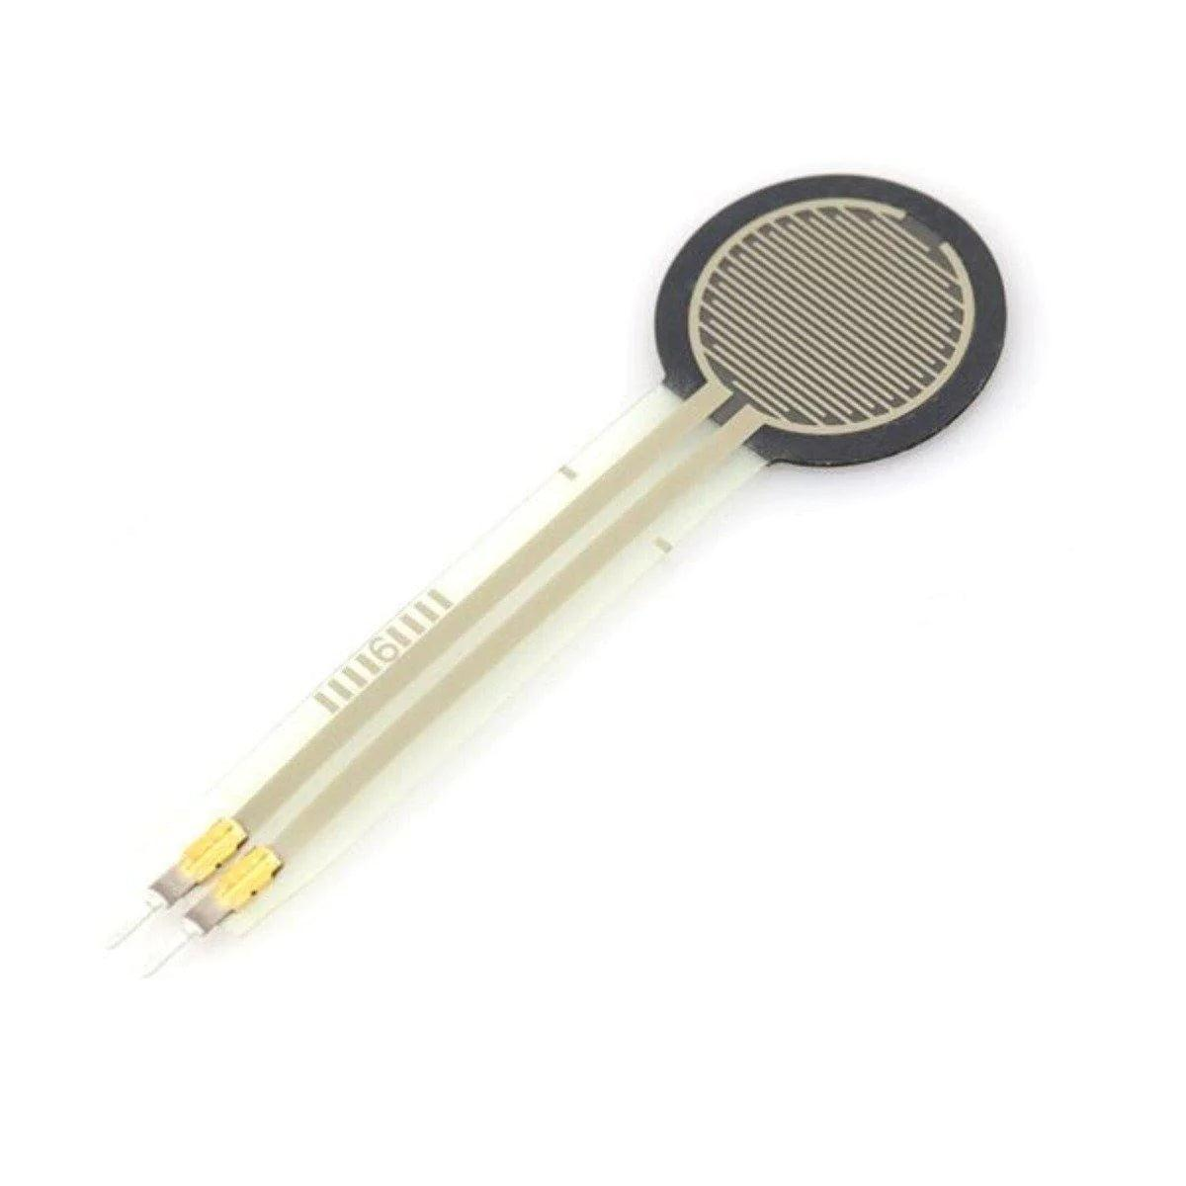
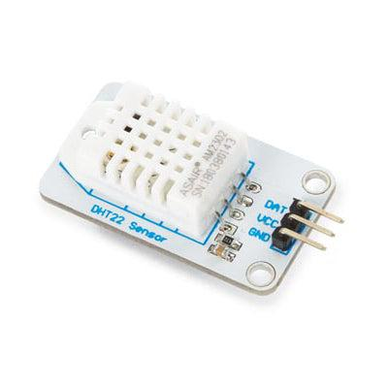
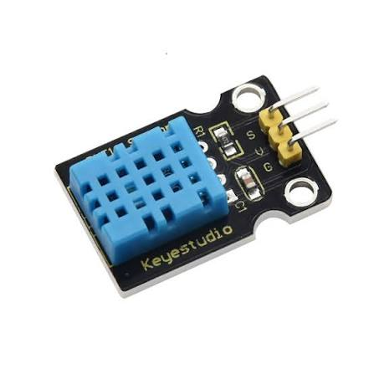
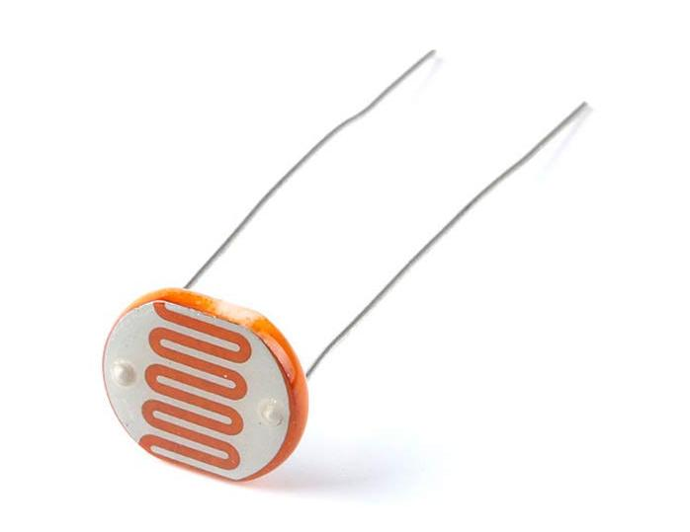
IOT SENSORS & DATAFLOW
IOT COMPONENT | SENSOR/COMPONENT TYPE | DATA COLLECTED/CONTROLLED | HOW ITS USED
FSR402 | FORCE / PRESSURE SENSOR | Occupied / Unoccupied | Detects whether the user is in bed and supports automatic alarm stopping.
DHT22 | TEMPERATURE | Room temperature (°C) & humidity | Environmental monitoring
LDR | LIGHT SENSOR(LDR) | Ambient light level | Automatically adjusts sunrise lighting based on room brightness.
PWN + DRIVER | Power Control Mechanism (Not a sensor) | Electrical power control | Adjustable mattress heating and vibration
ESP32 | MICROCONTROLLER | Processes all device inputs and outputs | Central SmartBed automation
Mp3 Module | Audio Output Module (Not a sensor) | Audio playback & volume | Customisable wake-up alarms

Slide 6
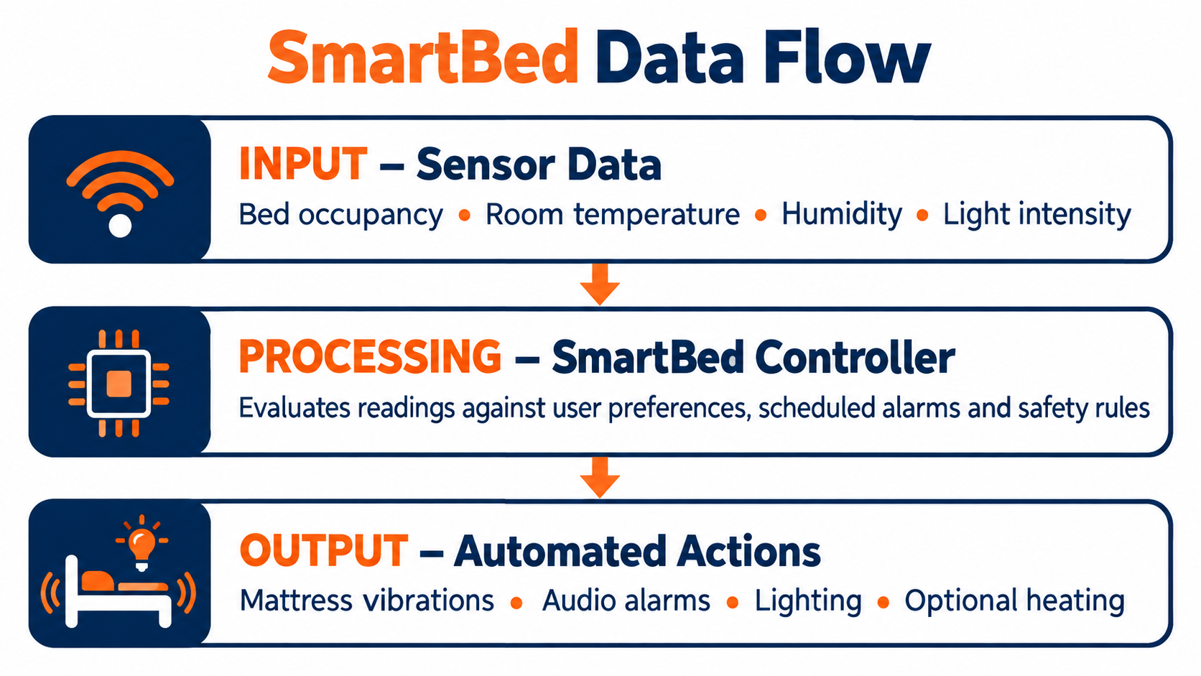

Slide 7
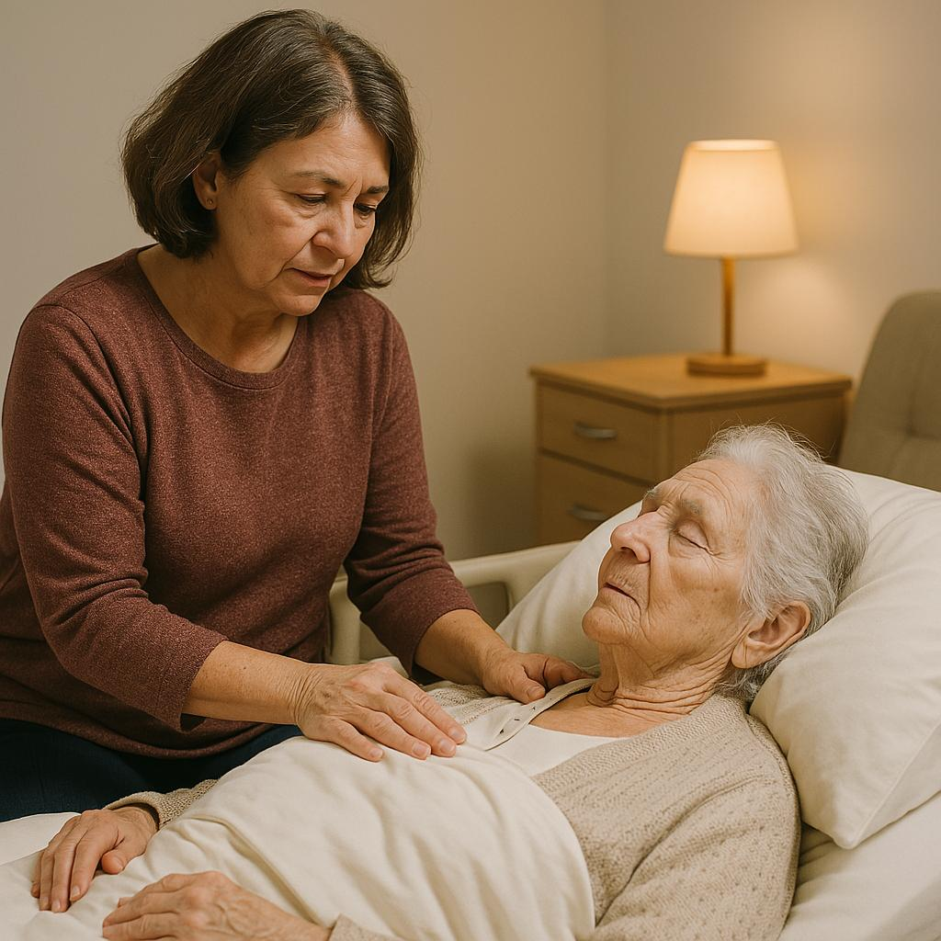
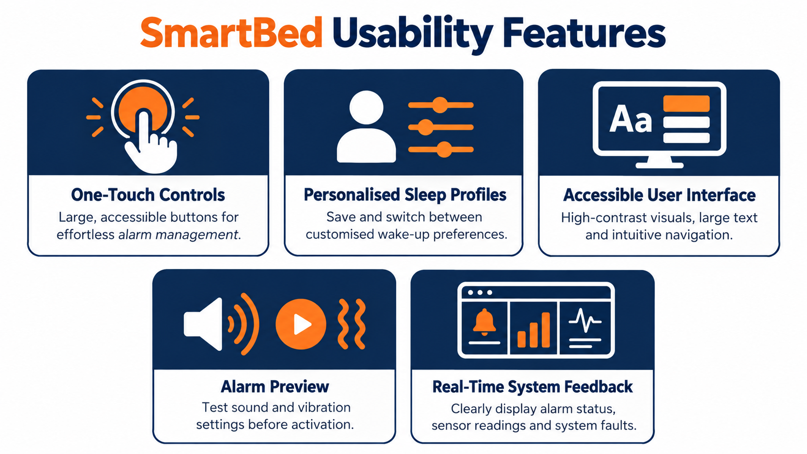
SmartBed – Users, Usability & Universal Design (UD)
SmartBed promotes independence, accessibility and personalised wake-up experiences through inclusive design.
Category | Description
Users | Heavy sleepers, elderly individuals, people with hearing impairments and users with limited mobility.
Usability | Simple web dashboard, customisable alarms, easy-to-use controls and accessible stop/snooze functionality.
Universal Design (UD) | Multi-sensory alerts (sound and vibration), large accessible buttons and adjustable settings to accommodate different physical and sensory abilities.

Slide 8
How SmartBed Implements Universal Design
Universal Design Principle | SmartBed Implementation | Benefit
Equitable Use | Multi-sensory alarms combining vibrations and sound | Supports users with different hearing abilities.
Flexibility in Use | Customisable vibration patterns, alarm sounds and intensity | Accommodates different sleeping patterns and personal preferences.
Simple & Intuitive Use | Accessible web dashboard with straightforward alarm settings | Reduces complexity for users of different ages and technical abilities.
Perceptible Information | Audio, vibrations and optional visual lighting alerts | Communicates wake-up alerts through multiple senses.
Tolerance for Error | Backup alarm behaviour when an individual output fails | Reduces the risk of missed alarms caused by component failures.
Low Physical Effort | Large snooze buttons and automatic alarm deactivation | Supports users with limited mobility.
Size & Space for Approach and Use | Accessible placement of physical controls | Makes buttons easier to reach and operate.

Slide 9
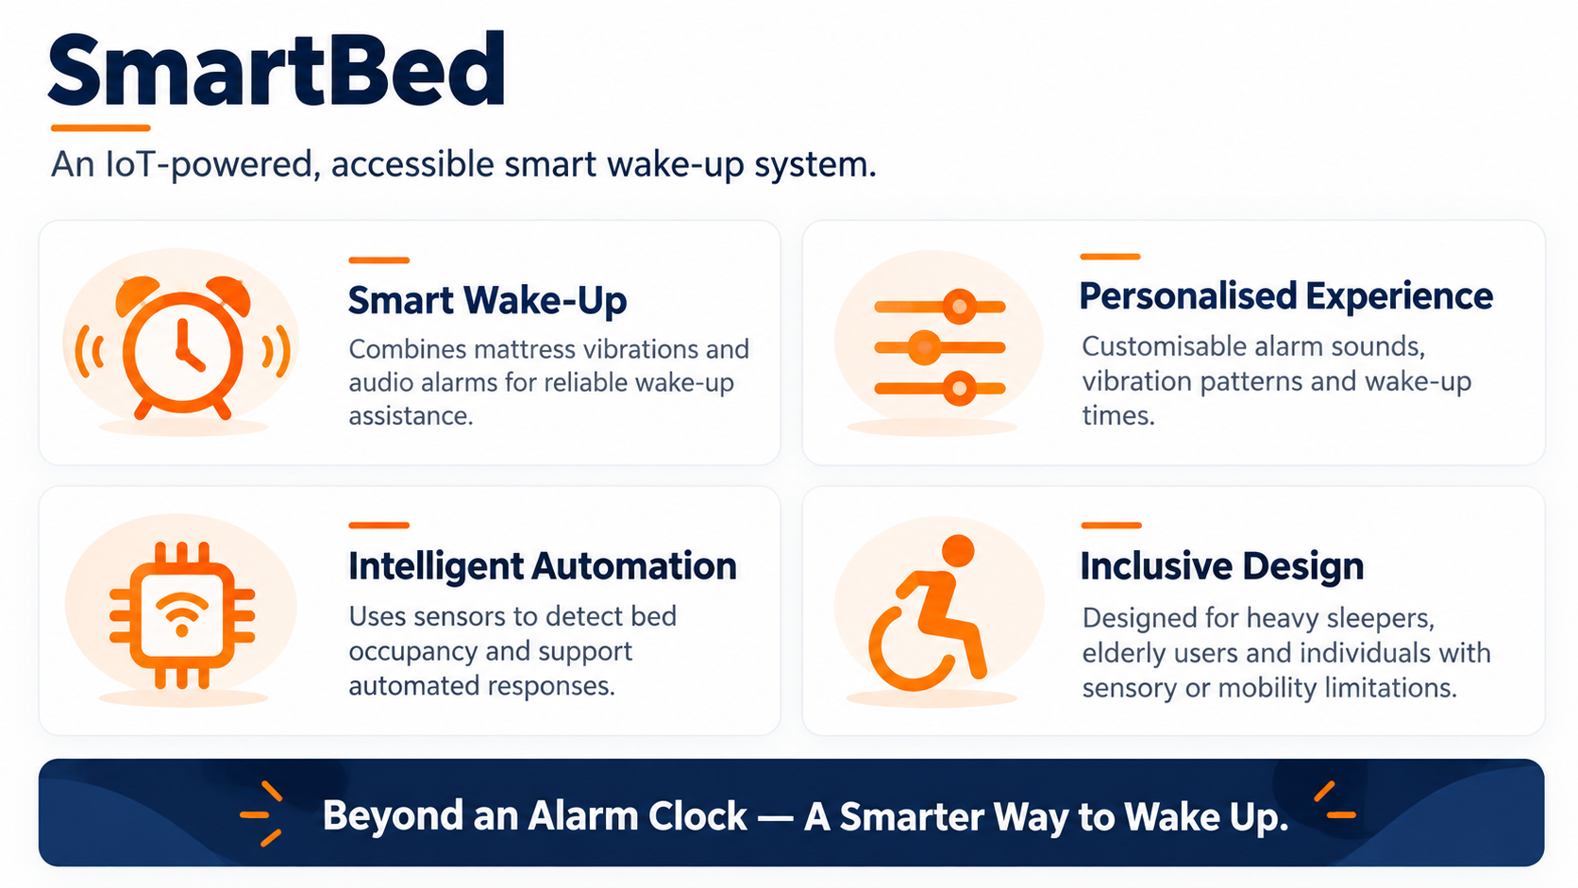
APP CONCEPT
Our concept is SmartBed, an IoT-based wake-up system designed to make waking up more personalised and accessible. Unlike traditional alarms that rely primarily on sound, SmartBed combines mattress vibrations, audio alerts and occupancy detection. Users can customise their experience through a simple web dashboard, making the system suitable for people with different sleeping patterns and accessibility needs.

Slide 10
WHAT MAKES SMART BED DIFFERENT?
"One SmartBed, multiple solutions — combining accessible wake-up technology, intelligent monitoring and personalised comfort."
Our Key Differentiator
Rather than relying on a single alarm or sensor, SmartBed brings accessibility, automation and comfort into one integrated system.
Innovation | USP
Multi-Sensory Wake-Up | Combines mattress vibrations and audio alarms to support different sensory needs.
Intelligent Bed Monitoring | Uses occupancy sensors to detect bed exits and support automated responses.
Adaptive Comfort | Integrates environmental sensors with optional heating and sunrise lighting.
Universal Design | Accessible controls and personalised settings accommodate users of different abilities.
Caregiver Support | Optional bed-exit alerts help caregivers monitor vulnerable users.

Slide 11
Thank you
UI / UX Testing: Uche Chibuikem
Database / Team Lead: Aleksy Cieslak
Prog. / SM : Adrian

